Slide 1
Hotel booking analysis
NAAN MUDHALVAN PROJECT
Presented By:
1. R.Janardhan – Surya Engineering College

Slide 2
OUTLINE
Problem Statement
Proposed System/Solution
System Development Approach
Algorithm & Deployment
Result
Conclusion
Future Scope
References

Slide 3
Problem Statement
Develop a comprehensive predictive model to determine the optimal timing for hotel room bookings, identify the ideal length of stay for obtaining the best daily rates, and predict the likelihood of hotels receiving an elevated number of special requests based on historical data.

Slide 4
Proposed Solution
Utilizing advanced machine learning algorithms, our solution will analyze extensive historical hotel booking data to establish patterns and correlations
For optimal timing, a predictive model will consider factors such as seasonality, demand fluctuations, and promotional periods, providing users with insights on when to secure the most cost-effective room rates.
The ideal length of stay will be determined through data-driven analysis, considering variables like day-of- week trends and duration-specific pricing strategies.
Additionally, a specialized model will predict the likelihood of hotels receiving elevated special requests by examining guest profiles, reservation details, and hotel amenities, enabling proactive management strategies for enhanced customer satisfaction

Slide 5
System Approach
Building the proposed solution would involve a combination of data processing, feature engineering, and machine learning. Here are the key system and library requirements:
System Requirements:
1. Hardware:
- À computer with sufficient processing power, preferably with multiple cores or a GPU for faster training of machine learning models
- Adequate RAM to handle the size of the dataset and computational requirements.
2. Software:
- An operating system compatible with the required machine learning libraries (e.g., Windows, Linux,macOS).

Slide 6
Algorithm & Deployment
Algorithm Selection
Data Exploration:
-- Explore the hotel booking dataset's structure, features, and target variable(s).
-- Identify potential patterns, correlations, and outliers
.Problem Formulation:
-- Define the problem: Predict optimal booking times ideal length of stay, and likelihood of special requeshistorical d
Algorithm Selection:
-- Regression tasks (e.g., predicting daily rates):
* Consider linear regression, decision trees, or ensemble methods (XGBoost, LightGBM).
-- Classification tasks (e.g., predicting special requests)
*Consider logisticdecisionor random forests

Slide 7
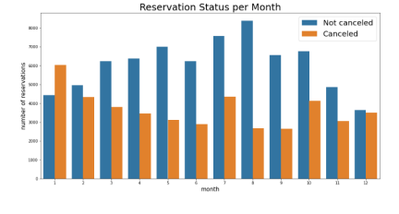
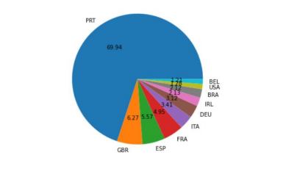
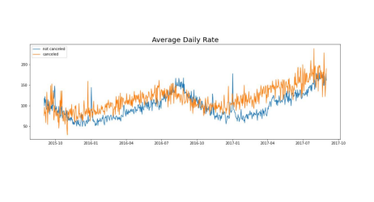
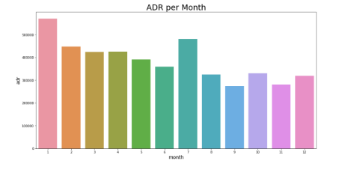
Result

Slide 8
Conclusion
We have developed the grouped bar graph to analyse the months with the highest and lowest reservation levels according to reservation status. As can be seen, both the number of confirmed reservations and the number of cancelled reservations are largest in the month of August, whereas January is the month with the most cancelled reservations.
The bar graph demonstrates that cancellations are most common when prices are greatest and are least common when they are lowest. Therefore, the cost of the accommodation is solely responsible for the cancellation.
As seen in the graph, reservations are cancelled when the average daily rate is higher that when it is not cancelled. It clearly proves all the above analysis. that the higher price leads to higher cancellations
The pie chart shows which country has the highest reservations cancelled. The top country is Portugal with the highest number of cancellations.

Slide 9
Future scope
The proposed solution lays the foundation for ongoing advancements in the realm of hotel reservation optimization. Here are key areas for future exploration and enhancement
Real-time Predictions:
* Move towards real-time predictive models that account for instant changes in demand, external events, and other dynamic factors to provide users with up-to-the-minute insights for booking decisions
Personalization and Customization:
* Enhance the predictive models to offer more personalized recommendations by considering individual guest preferences, loyalty history, and user-specific requirements, providing a tailored experience for each traveler.

Slide 10
References
https://www.kaggle.com/datasets
https://pandas.pydata.org/pandas-docs/stable/user guide/index.html
https://seaborn.pydata.org/
https://matplotlib.org/stable/contents.html

Slide 11
THANK YOU

